Slide 1
Familiarisation experiment
MATLAB and LTSPICE
Ritu Ann Roy George
B170106ec
S7 ece b batch

Slide 2
Matlab
MATLAB is a programming platform designed specifically for engineers and scientists. The heart of MATLAB is the MATLAB language, a matrix-based language allowing the most natural expression of computational mathematics.
Using MATLAB, we can:
Analyze data
Develop algorithms
Create models and applications
MATLAB finds applications in many domains such as data analytics, computational Biology, computational finance, wireless communications and Internet of Things.

Slide 3
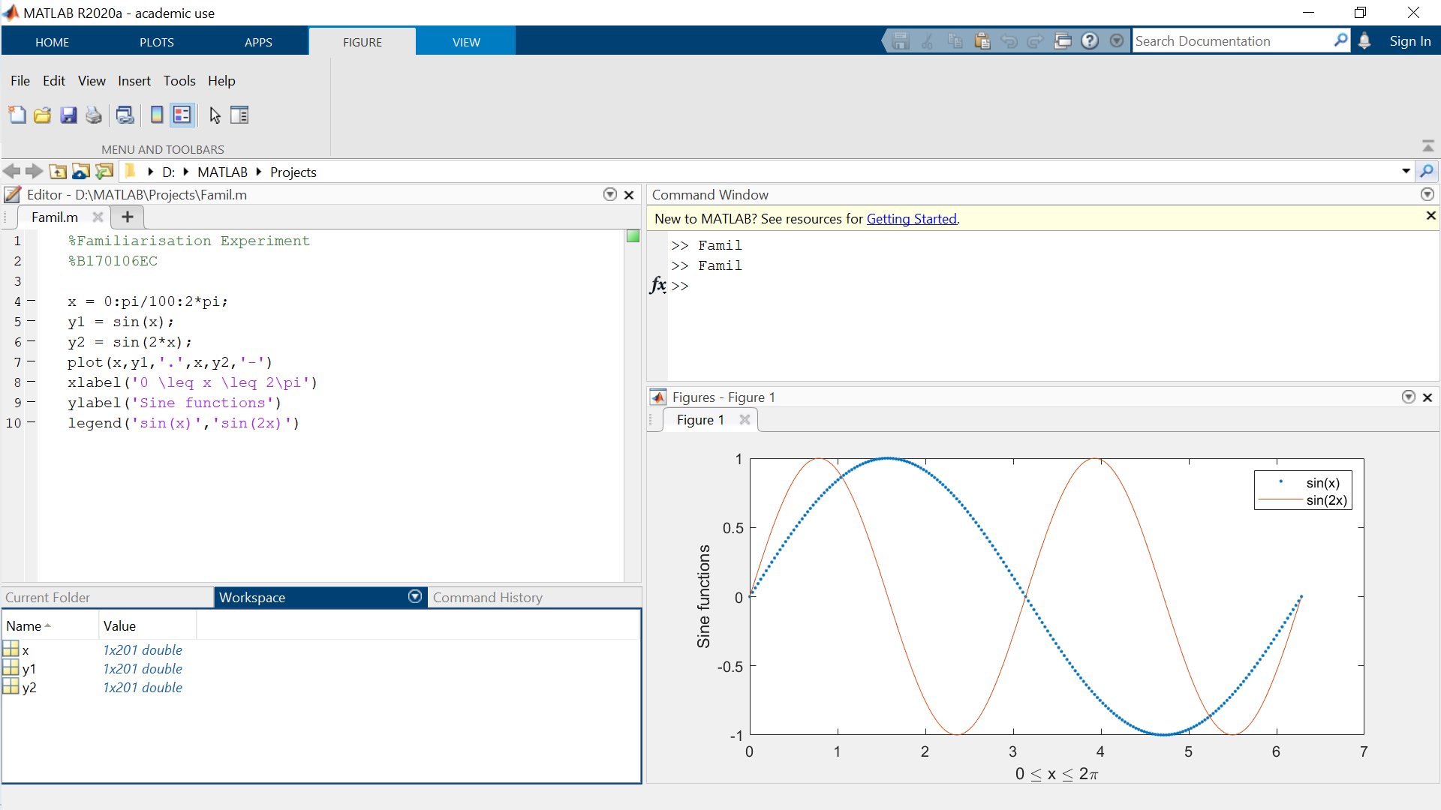
Tools
Matlab: Windows
Command Window
Workspace Window
Current Folder Window
Command History Window
Toolboxes
Control Systems Toolbox
DSP Toolbox
Image Processing Toolbox
Inbuilt Commands and Functions
clc, help
zeros(a,b), cos(x)

Slide 4
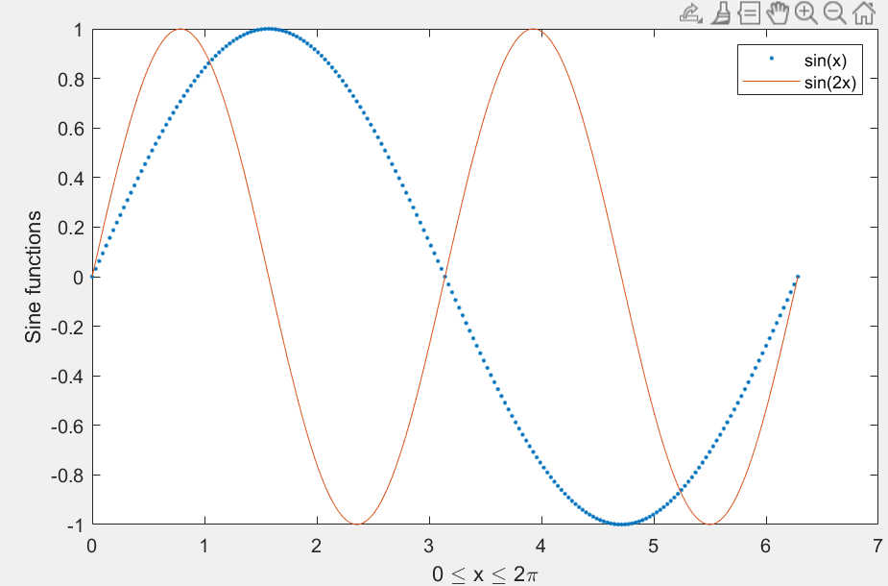
Matlab program
AIM: To plot a sine curve on MATLAB
THEORY: MATLAB has an inbuilt trigonometric function sin(x) that generates the curve in the specified range for x
ALGORITHM:
Specify range for input x
Generate two sine curves sin(x) and sin(2x)
Plot both the figures on the same plot.
OBSERVATION
ALGORITHM:

Slide 5
LTSPICE
LTspice is a SPICE-based analog electronic circuit simulator computer software, produced by Analog Devices (originally by Linear Technology). It is the most widely distributed and used SPICE software in the industry.
Advantages of Ltspice:
Outperforms many simulation solutions in the market
Not hobbled by any arbitrary limits - Stable circuit simulation with unlimited number of nodes
Freeware

Slide 6
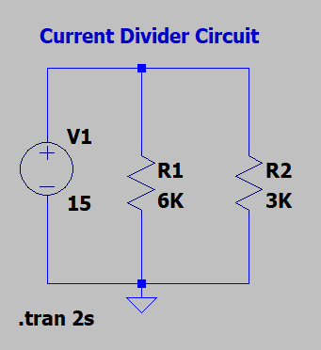

LTSpice Simulation
AIM: To simulate a resistive current divider circuit
THEORY: For 2 resistors in parallel, current through each resistor is divided in the ratio:
$$\frac{I_{2}}{I_{1}}=\frac{R_{1}}{R_{2}}$$
$$I_{{(R}_{1 or 2})}=I∗\frac{R_{2 or 1}}{R_{1}+R_{2}}$$
For a voltage source of 15V and
$${if R}_{1}=6K\text{Ω} and R_{2}=3K\text{Ω}, then$$
$$R_{net}=3K\text{Ω}, net current I=7.5mA$$
$$I_{1}=2.5mA and I_{2}=5mA$$
CIRCUIT DIAGRAM

Slide 7
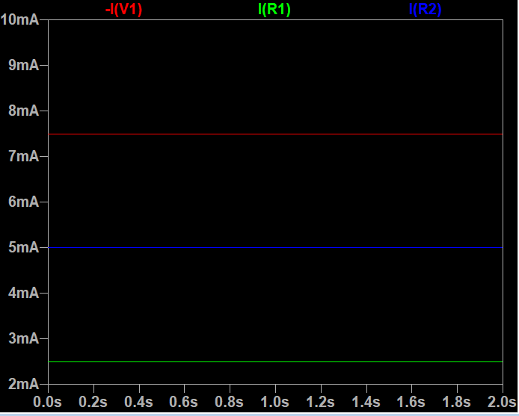
LTSpice Simulation
ALGORITHM:
Connect the components.
Switch on the voltage supply
Measure the current flowing through each resistor and plot the figures on the same plot.
RESULT: The simulation values agree with the calculated current values.
OBSERVATION

Slide 8
Conclusion
INFERENCE:
The current through the voltage source is shown to be of negative value since LTspice assumes energy used by loads as positive and that used by sources as negative.
LTspice produces fast, accurate simulation results.
Both MATLAB and LTspice are immensely helpful for circuit analysis.
RESULT:
Familiarised with MATLAB and LTspice by performing simple simulation experiments.

Slide 9
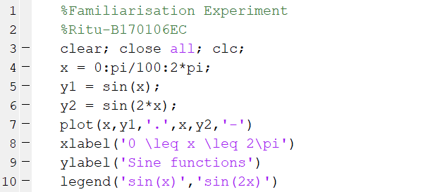
Additional Material:
Matlab code:

